Slide 1
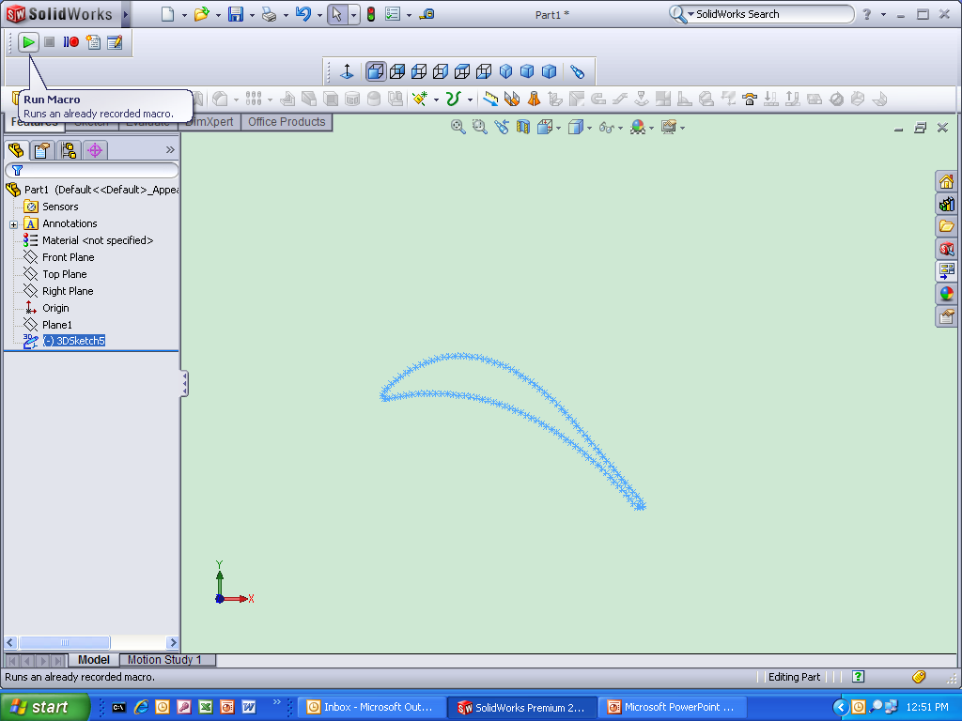
Exporting and importing data points in sketches
NOTE:
POINTS BEING IMPORTED BACK INTO SW WILL BE // TO THE FRONT PLANE AND BE SURE THERE ARE ONLY POINTS. END POINTS OF LINES, ARCS ETC WILL BE EXPORTED AS WELL
2. Click on “Run Macro”
1. Highlight desired sketch
Notes:
EXPORTING AND IMPORTING POINTS IN SKETCHES

Slide 2
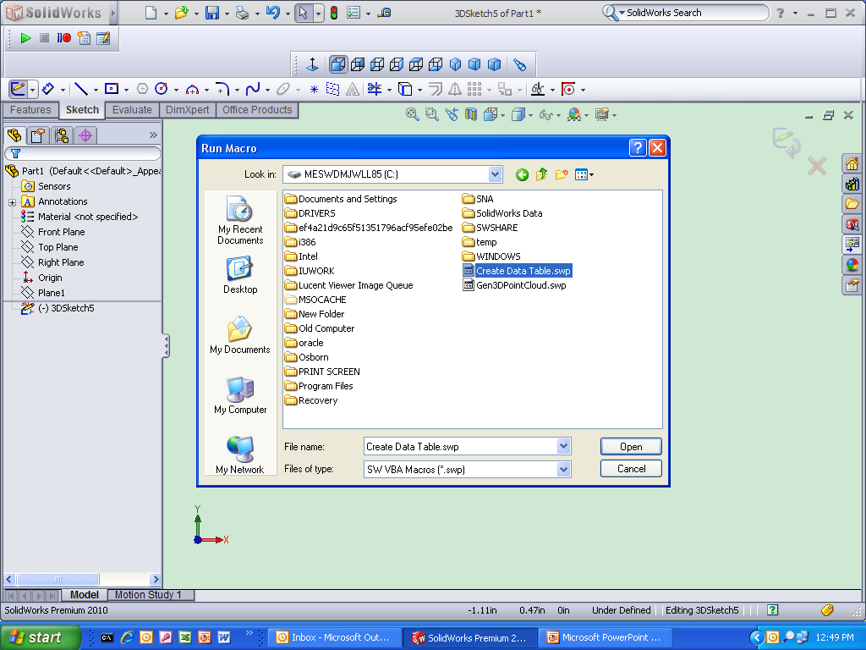
Open “Create Data Table.swp”

Slide 3
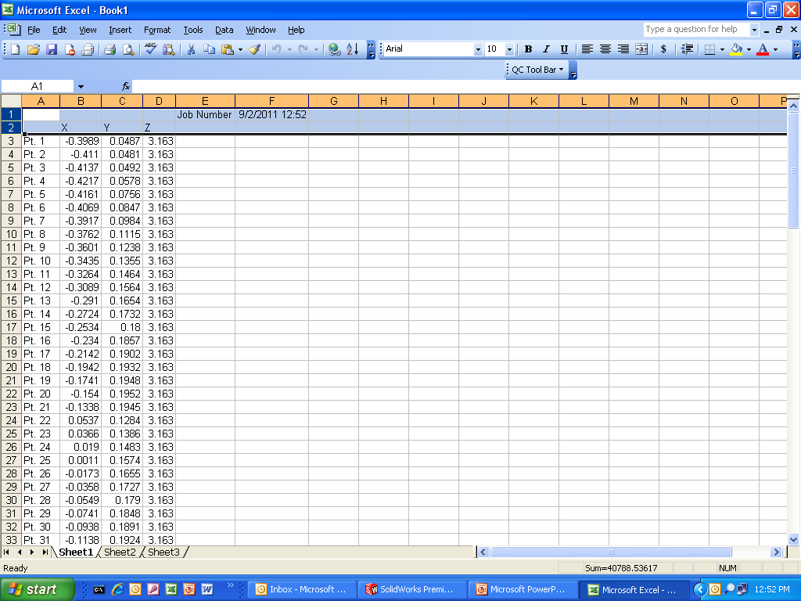
Delete these 2 rows and column A

Slide 4
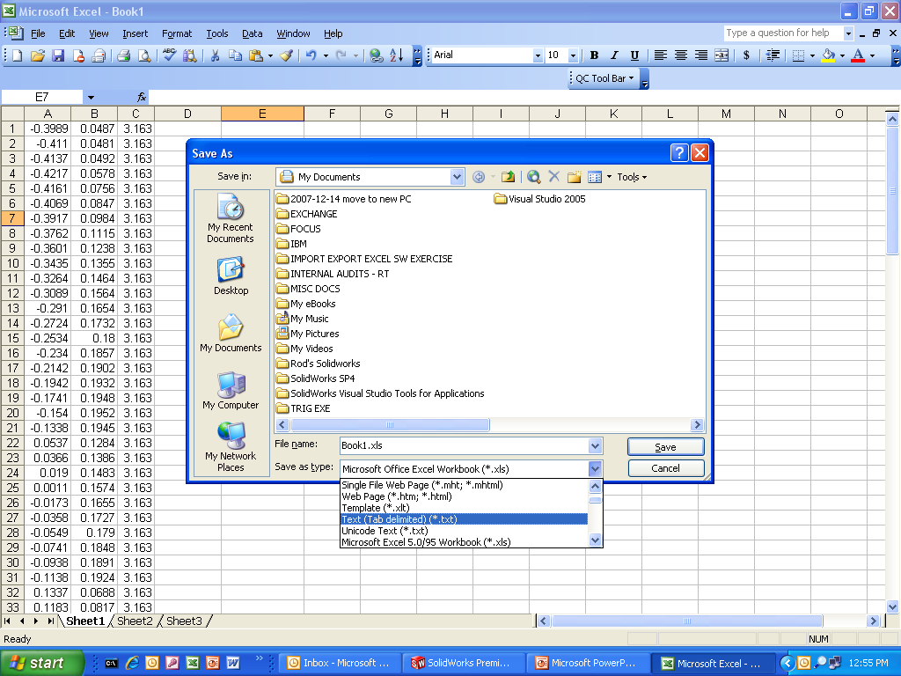
File save as “Text (Tab delimited) (*.txt)”

Slide 5
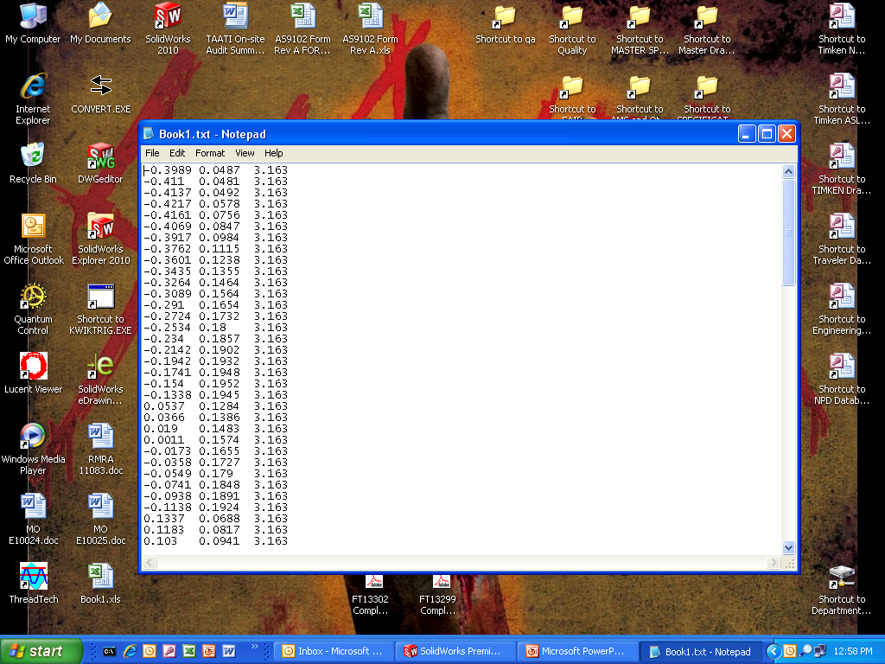
This what the file should look like.

Slide 6
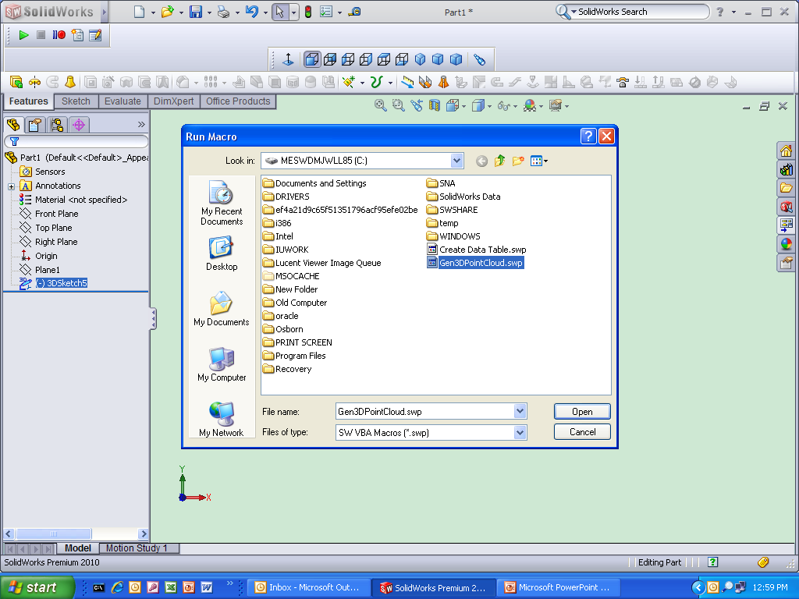
Open “Gen3DPointCloud.swp”

Slide 7
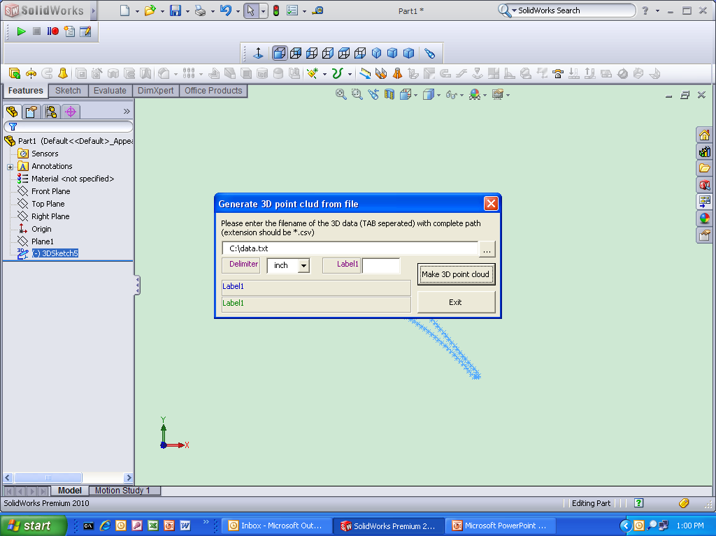
Click this button to browse

Slide 8
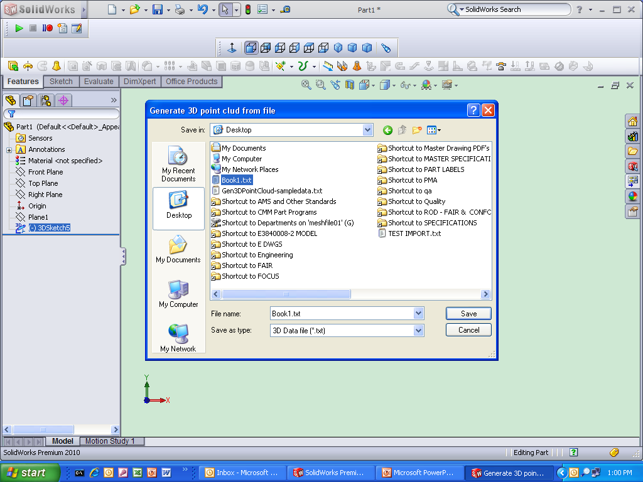
Select .txt file created from xls file on sheet 4

Slide 9
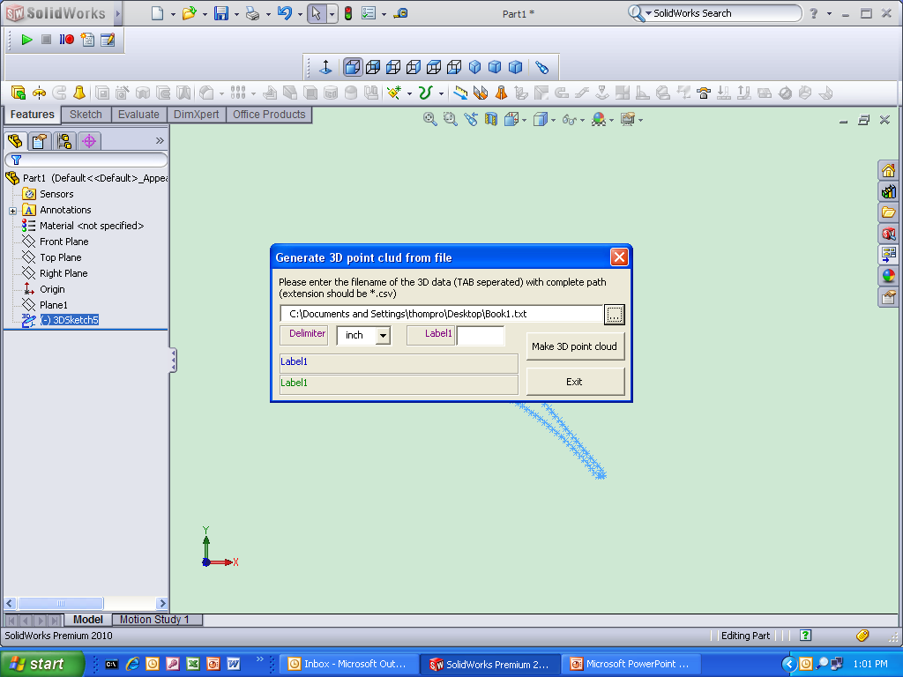
Click “Make 3D point cloud”

Slide 10
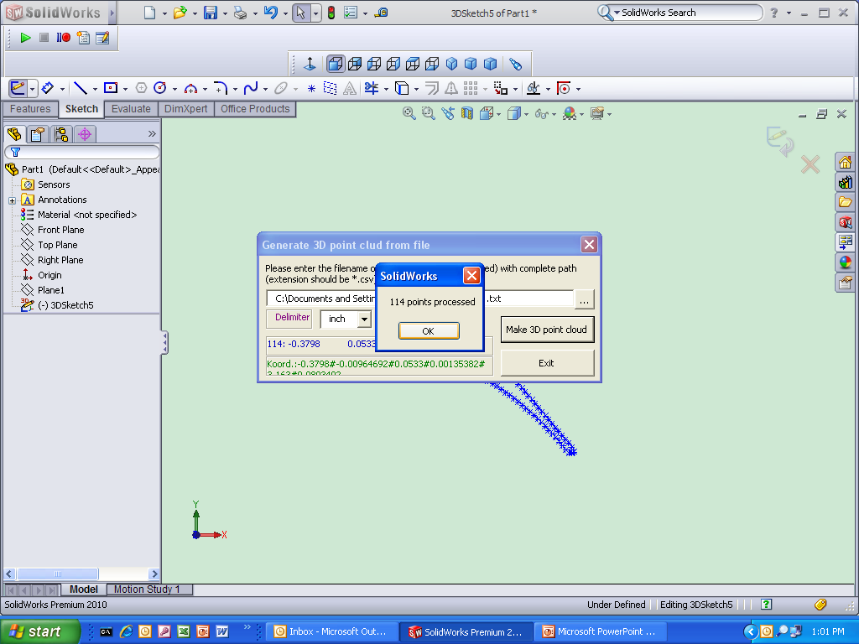
Click “OK” and “Exit”

